Slide 1
BRAISING PANS
GROEN

Slide 2
BRAISING PAN VERSATILITY
Griddle pancakes, sausage and eggs
Cook soup and grill hamburgers
Boil pasta & sauce and steam vegetables
Stir-fry an entrée or slow-cook a roast
Make pudding
Notes:
Performance & Cooking Versatility
— Braise, Grill, Poach, Steam, Bain Marie, Cook and/or Hold!
The Eclipse ergonomic tilting braising pan continues to outperform the competition in performance, water resistance and ergonomics — all with a streamlined, efficient design. The Eclipse is a multitasking, hard-working, high performance braising pan — so versatile it can braise, grill, poach, steam, bain marie, cook and/or hold almost all menu options. Whether you choose the 30 or 40 gallon model, either gas or electric, manual or power tilt, you’ll own a fast, high capacity unit that will get the job done year after year.

Slide 3
FLOOR MODEL BRAISING PANS
15, 30 & 40-gallon capacity
Electric, natural gas and propane
Electric ignition or standing pilot (gas, manual-tilt only)
Center tilt
Open frame- tubular leg
Available on CASTERS
Notes:
Performance plus
It’s ready when you are. The Eclipse heats to 350˚F in just four minutes and evenly delivers tremendous cooking power. The floor of the pan is specially designed to distribute heat uniformly across the entire flat surface, eliminating troublesome uneven hot or cold areas found in competitive units. The flat cooking surface is designed to stay that way year after year so there’s no burning or pooling.
Ergonomic by design
The narrow-width footprint saves on expensive hood space. With only one control box, controls are centrally located and at an angle that ensures easy viewing and access. The streamlined, rounded leg stands are easy to clean, meeting all NSF requirements. The faucets are easier to reach by being located closer to the front and have the option of being right-, left-handed, or rear-mounted. The famous easy to clean, rounded interior has no corners to clean.
Defies water ingress
Kitchens get wet, especially during cleanup time, and the Eclipse is designed to resist splashback and spray. The control box is sealed and the gas igniter or pilot is shielded. The worm gear mechanism is covered to block water so there’s no worry when cleaning.
Easy, steady pouring
The center-tilt design has a shorter pour, consumes less aisle space and is designed to effectively flow the contents of the unit with minimal surge or drip.

Slide 4
WHY ADD A 15 GALLON VERSION
30-1/2” Allows for greater versatility in a smaller foot print than ever before.
Shorter pan height for ease of use
More BTU’s or KW per gallon of capacity than ever before.
Two units will come close to the same footprint as the 30 ga. Versatility.
Notes:
Performance plus
It’s ready when you are. The Eclipse heats to 350˚F in just four minutes and evenly delivers tremendous cooking power. The floor of the pan is specially designed to distribute heat uniformly across the entire flat surface, eliminating troublesome uneven hot or cold areas found in competitive units. The flat cooking surface is designed to stay that way year after year so there’s no burning or pooling.
Ergonomic by design
The narrow-width footprint saves on expensive hood space. With only one control box, controls are centrally located and at an angle that ensures easy viewing and access. The streamlined, rounded leg stands are easy to clean, meeting all NSF requirements. The faucets are easier to reach by being located closer to the front and have the option of being right-, left-handed, or rear-mounted. The famous easy to clean, rounded interior has no corners to clean.
Defies water ingress
Kitchens get wet, especially during cleanup time, and the Eclipse is designed to resist splashback and spray. The control box is sealed and the gas igniter or pilot is shielded. The worm gear mechanism is covered to block water so there’s no worry when cleaning.
Easy, steady pouring
The center-tilt design has a shorter pour, consumes less aisle space and is designed to effectively flow the contents of the unit with minimal surge or drip.

Slide 5
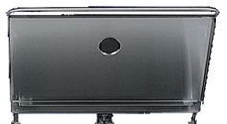
LID FEATURES
One-piece cover
4” adjustable vent
Seamless condensate lip
Torsion spring hinges
Notes:
Counterbalanced cover design
The Eclipse tilting braising pan’s improved, counterbalanced cover design ensures ease of assembly and easier cleaning to meet all NSF standards. The fully adjustable cover will stay put wherever it’s set for ease of operation. The cover allows for controlled steam venting while the adjustable steam vent controls condensate during cooking. The integral condensate drip lip returns water to the product, not on the floor behind the unit. The heavy-duty cover lets you oven-cook all meats, poultry, and seafood. Fewer working parts assure increased durability and higher performance.

Slide 6
CONTROL BOX
Thermostatically controlled
Tilting cut-off switch
24 turn worm gear
Power tilt available
Water resistant controls
Faucet bracket standard
Notes:
Precision controls
The precision thermostat regulates temperature for accurate cooking every time and has a dependable electronic ignition. The patented burner system, with high efficiency, means lower energy costs.

Slide 7
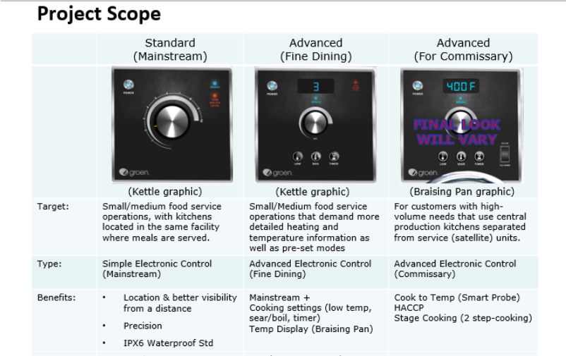
GROEN CONTROLS PROJECT

Slide 8
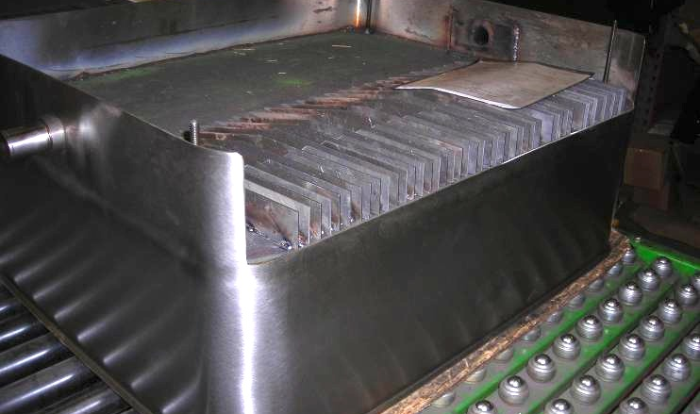
SHORT AND LONG FINS PROVIDE EVEN HEAT DISTRIBUTION

Slide 9
THERMOCOUPLE SENSES AN AVERAGE AREA TEMPERATURE VS A SINGLE POINT

Slide 10
3” RADIUS CORNER VS. COMPETITORS STANDARDS
Which would you like to clean the next 20 years.

Slide 11
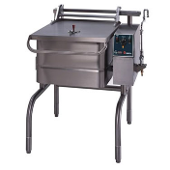
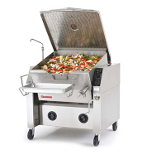
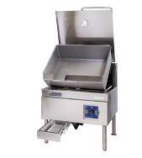
WHY OPEN LEG STANDS VS. CABINET STYLE
No Pinch Points for accidents to happen.
No hiding places for vermin or infestations.
Far easier to clean (saving Time)
Center Pivot provides a shorter pour path

Slide 12
TD/FPC TABLE TOP BRAISING PAN
Manual-tilt
10-gallon
Electric only
Optional stand and drain cart

Slide 13
STEAMER PAN CARRIER (40 & 30 GALLON ONLY)

Slide 14
GROEN SIGNATURE

Slide 15
STANDARD WARRANTIES
All braising pans are covered by a (1) year standard warranty
A (10) year body warranty
2 year K-12 school warranty

Slide 16
COMPARATOR

Slide 17
TAKE AWAYS
10, 15, 30 and 40 gallon models
3” radius corners
100 grit hand rotary sanded pan
10 year pan warranty
Gas – fin design for unmatched heat uniformity
Electric – Plate elements for unmatched heat uniformity
Narrowest pour path in the industry
Casters will work on all 4 legs
Open tubular frame design – No pinch points, easy to clean, no place for infestations
Least amount of turns to reach full tilt
Standard faucet bracket

