Slide 1
STEAM JACKETED KETTLES
GROEN

Slide 2
THE STAINLESS STEEL STEAM JACKETED KETTLE
The Function
The Categories
The Application

Slide 3
THE JACKET
It’s a pressure vessel designed to transfer heat or energy from itself to the product inside it
How it works
Hemispheres
ASME
Energy
Pressure
Conduction

Slide 4
WHY USE A KETTLE
Labor / Waste
Product quality
Product consistency
Safety
Energy efficient
Ease of cleaning
Speed of cooking
Ergonomics
Space limitations

Slide 5
AVAILABLE BOILERS
GAS BOILER is available in 200,000 BTU’s delivering approximately 3.7 horse power at about 12 PSI.
Electric Boiler is available in 24, 36 and 48 KW providing 2.2, 3.5 and 4.7 BHP respectively at about 12 PSI.
Note: rule of thumb is 20 gallons of kettle capacity per boiler horse.

Slide 6
COMPETITORS RIM “ROLLED STYLE”

Slide 7
OUR RIM “REINFORCED”
No place for dirt and grime to hide…
No denting after time in use…
Which would you rather have a rolled or reinforced rim?

Slide 8
DIFFERENCES IN STANDARDS
Kettles get hot and boil overs happen. With a mirrored surface it is much easier to clean baked on product than that of a brushed finish.
A mirrored finish also gives the perception of cleanliness to visiting health inspectors.
Esthetically mirrored finish is much more appealing to visiting customers or front of the house locations.

Slide 9
MIXER KETTLES
40-60-80 gallon mixer kettles…
50PSI standard
INA – inclined
TA – vertical
Flush mount ball valves
Available on direct steam
Floor models
Table top models
Available in 20 and 40
Quart Capacities

Slide 10
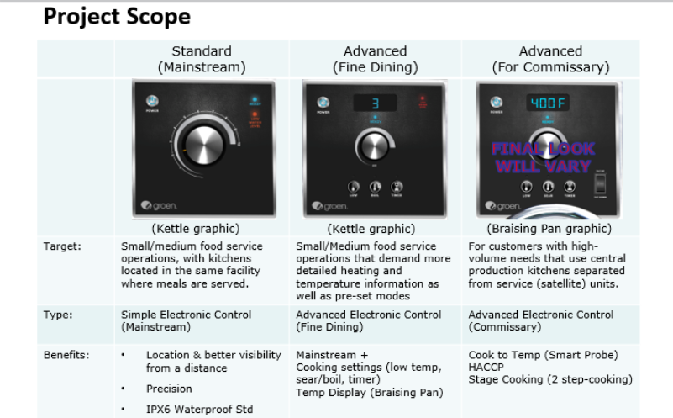
GROEN CONTROLS PROJECT

Slide 11
COMPARATOR

Slide 12
COMPARATOR

Slide 13
COMPARATOR

Slide 14
COMPARATOR

Slide 15
STANDARD WARRANTIES
ALL KETTLES ARE COVERED BY A (1) YEAR STANDARD WARRNTY
A (10) YEAR BODY WARRANTY
2 year K-12 school warranty

Slide 16
PRESSURE VS. TEMPERATURE
PSI | TEMP (F) | PSI | TEMP (F)
0 | 212 | 55 | 303
5 | 227 | 60 | 307
10 | 239 | 65 | 312
15 | 250 | 70 | 316
20 | 259 | 75 | 320
25 | 267 | 80 | 324
30 | 274 | 85 | 328
35 | 281 | 90 | 331
40 | 287 | 95 | 335
45 | 292 | 100 | 338
50 | 298 | 105 | 341

Slide 17
KETTLE SIZING CHART
Working capacity is about 80%
Allow for growth
Multiple kettle flexibility
KETTLE SIZE |  | PORTIONS: (SERVINGS CALCULATED)
NOMINAL CAPACITY | WORKING CAPACITY | 1 OZ | 2 OZ | 3 OZ | 4 OZ | 6 OZ | 8 OZ
5 GALLONS | 4 GALLONS | 512 | 256 | 170 | 128 | 85 | 64
6 GALLONS | 4.8 GALLONS | 614 | 307 | 204 | 153 | 102 | 76
10 GALLONS | 8 GALLONS | 1024 | 512 | 341 | 256 | 170 | 128
12 GALLONS | 9.6 GALLONS | 1228 | 614 | 409 | 307 | 204 | 153
20 GALLONS | 16 GALLONS | 2048 | 1024 | 682 | 512 | 341 | 256
40 GALLONS | 32 GALLONS | 4096 | 2048 | 1365 | 1024 | 682 | 512
60 GALLONS | 48 GALLONS | 6144 | 3072 | 2048 | 1536 | 1024 | 768
80 GALLONS | 64 GALLONS | 8192 | 4096 | 2730 | 2048 | 1365 | 1024
100 GALLONS | 80 GALLONS | 10240 | 5120 | 3413 | 2562 | 1706 | 1280
125 GALLONS | 100 GALLONS | 12800 | 6400 | 4266 | 3200 | 2133 | 1600
150 GALLONS | 120 GALLONS | 15488 | 7744 | 5162 | 3872 | 2581 | 1936
Notes:
Better to over size than under. Two smaller kettle can offer more versatility.

Slide 18
CALCULATOR

